Slide 1
Network-Based Association Study of Protein Sets
Abstract (293 words so far)
We present a protocol of Network-Based Association Study (NetBAS). NetBAS interprets categorical terms associated with protein sets by mapping to physical protein-protein interaction (PPI) network of the cell. Particular categorical variables include gene ontology (GO) and biological pathways, which are of indispensable importance in extracting the biology of protein sets from high-throughput genomic studies. Traditional GO/pathway enrichment tools statistically assess over-presented annotations carried by protein sets compared to a selected background. Enrichment tools using PPI networks have also been developed. The rational of network-based methodologies resides in the fact that proteins conduct functions through interactions with other proteins inside or at the surface of the cell. NetBAS inspects the network versus its null permutations to evaluate categorical terms (e.g., GO/pathway) that are over-expressed in neighbor proteins interacting with members of the protein set. Uniquely, NetBAS applies two criteria for the null permutations, which 1) have nodes from random sampling of the whole network and 2) have all protein degrees conserved. Total number of each categorical term is therefore preserved in null permutations as original protein set, and subsequently calculated z-scores statistically quantify the enrichment scales of all terms attributed to the protein set. We tested 50 hallmark sets and 32 KEGG pathway sets from MSigDB, and found that many of the enriched terms disclosed by NetBAS were also hit by a traditional tool, DAVIS. Unneglectable differences between NetBAS and DAVID also exist. NetBAS can therefore serve as a useful complement in enrichment analysis. Moreover, as the size of the neighbor set is considerably bigger than the original set, NetBAS is effective to small protein sets, or even to a single protein. The human PPI network used in present work can be extended to other networks such as genetic interaction network or regulatory network.

Slide 2
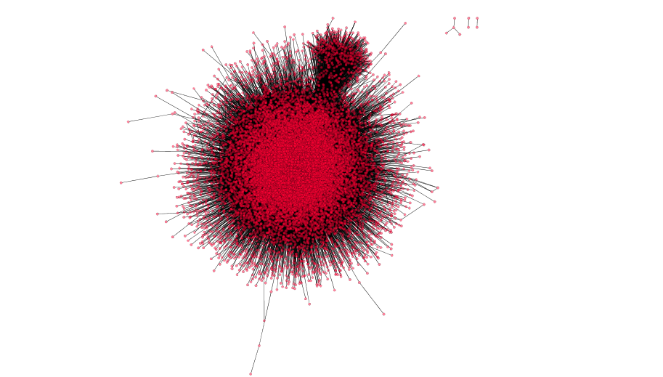

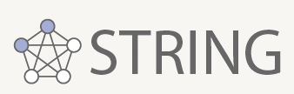
PPI Networks
Other resources
The International Molecular Exchange Consortium
HPRD
The Molecular INTeraction database
Consensus Pathway DataBase
Database of Interacting Proteins (DIP)
BioPlex
(Biophys interaction of ORFeome-based complexes)
MPIDB: the microbial protein interaction database
Inweb_InBioMap (2017)
592,685 edges
16,641 vertices (proteins)
Nature Biotech. 2007
Nature Methods 2017

Slide 3
Gene Ontology & KEGG Pathway
Gene ontology consortium
BP: Biological Process (11,983 terms)
CC: Cellular Component (1,717 terms)
MF: Molecular Function (4,184 terms)
MAPPING?
Kyoto Encyclopedia of Genes and Genomes (318 pathways)
Metabolism
Genetic Information Procession
Environmental Information Procession
Cellular Processes
Organismal Systems
Human Diseases
Drug Development

Slide 4
Molecular Signatures Database v6.2
H: hallmark gene sets (50 gene sets) | Hallmark gene sets summarize and represent specific well-defined biological states or processes and display coherent expression. …
50 Hallmark Gene Sets
CP:KEGG: KEGG gene sets (186 gene sets) | Gene sets derived from the KEGG pathway database.
32 KEGG Gene Sets related to diseases
Traditional enrichment tool, DAVID (https://david.ncifcrf.gov)

Slide 5
HALLMARK_OXIDATIVE_PHOSPHORYLATION
Subnetwork: 189 vertices, 1380 edges
(unconnected vertices omitted)
2 largest cliques w/ degree = 28

Slide 6
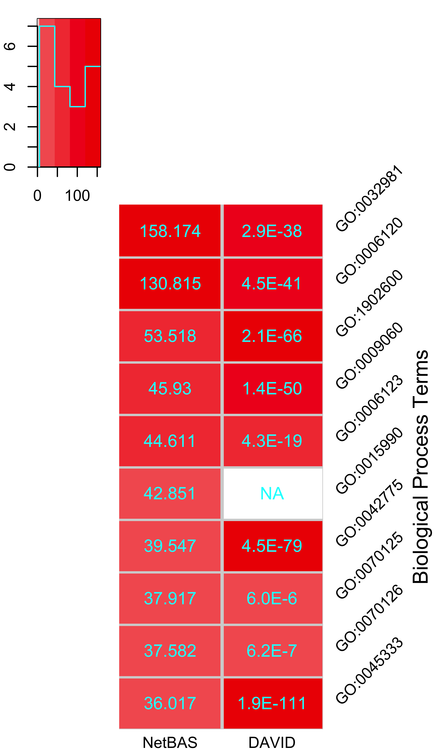
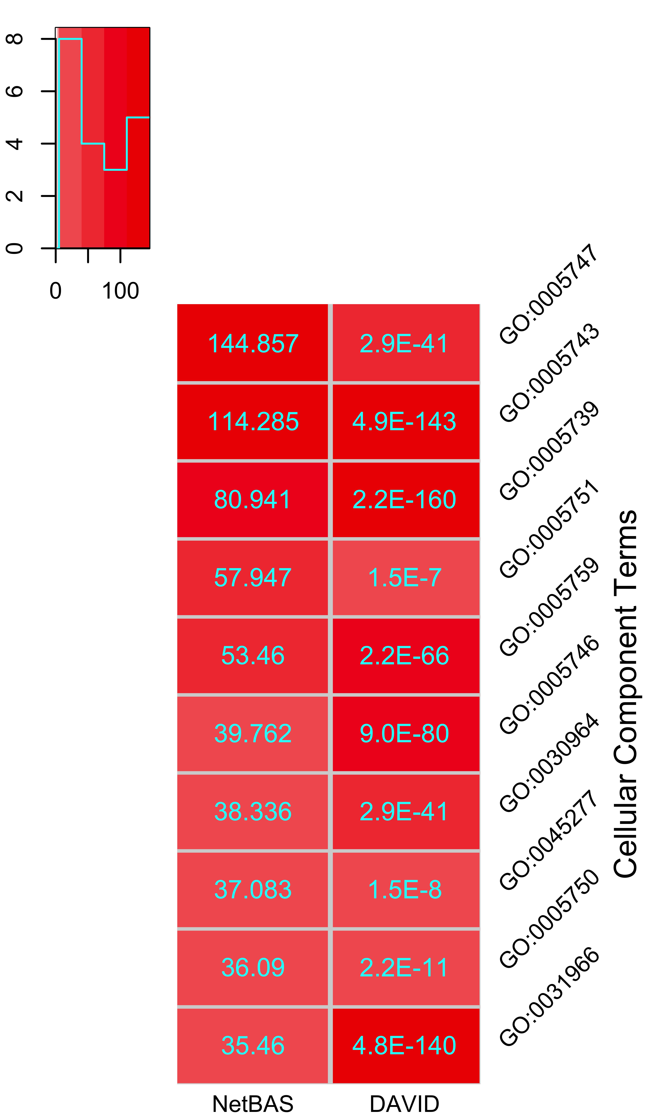
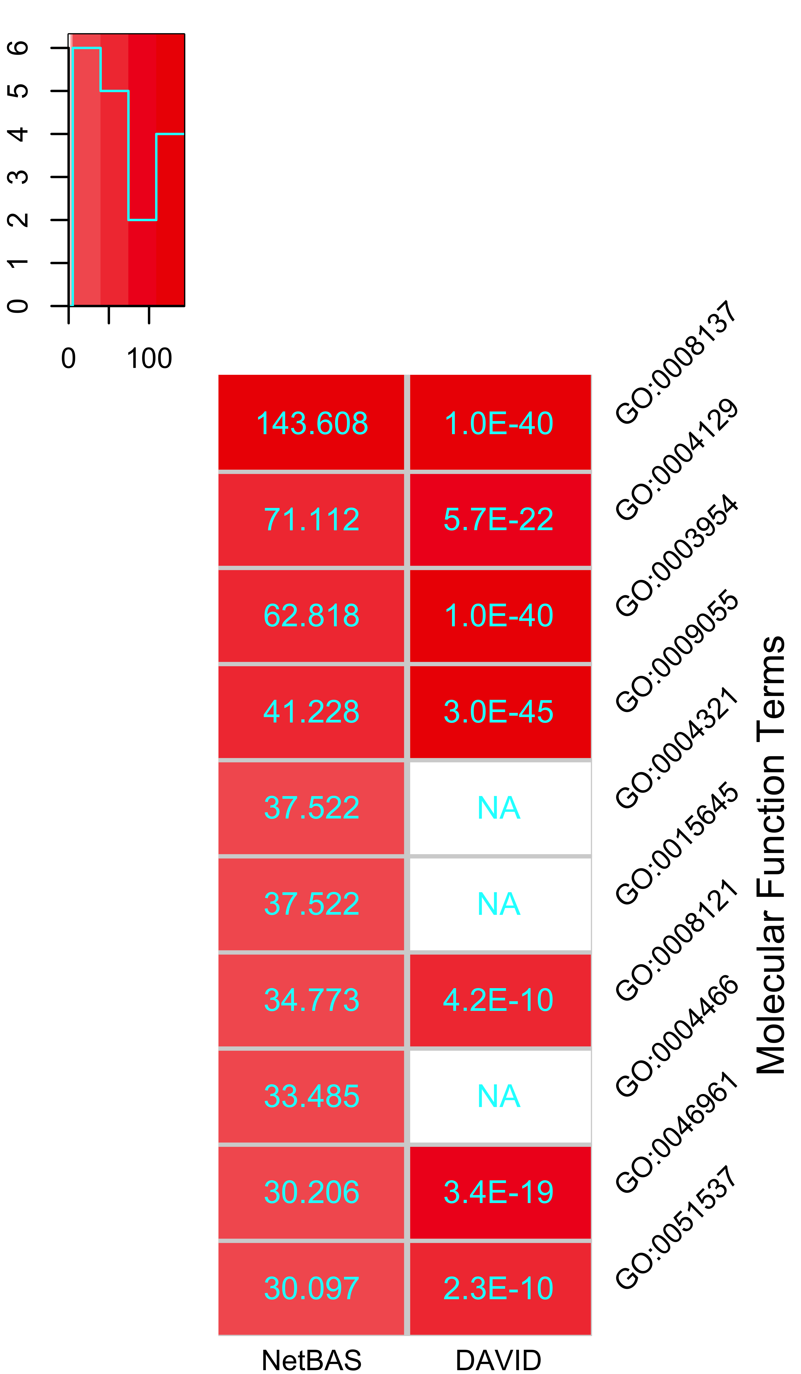
HALLMARK_OXIDATIVE_PHOSPHORYLATION

Slide 7
HALLMARK_KRAS_SIGNALING_DN
Subnetwork: 184 vertices, 93 edges
(unconnected vertices omitted)
1 largest cliques w/ degree = 9

Slide 9
Architecture of the sub-network is correlated with the Z-scores calculated by NetBAS
Top 10 KEGG pathways
HMK.set.name | Vertice# | Edge# | MaxD | MaxD.gene | Clust.Coeff.Global | Clust.Coeff.Average | Diameter | Mean.Distance | Max.Cliq.num | Max.Cliq.D | KEGG.z.max | KEGG.z.mean
HALLMARK_ADIPOGENESIS | 171 | 445 | 159 | UBC | 0.123372949 | 0.598413588 | 5 | 2.101823185 | 5 | 10 | 23.029 | 16.8702
HALLMARK_ALLOGRAFT_REJECTION | 174 | 616 | 40 | LCK | 0.398335153 | 0.531477754 | 9 | 3.338490731 | 2 | 11 | 52.186 | 45.9696
HALLMARK_ANDROGEN_RESPONSE | 49 | 55 | 10 | UBE2I | 0.132352941 | 0.174444444 | 10 | 3.929238985 | 6 | 3 | 10.325 | 7.917
HALLMARK_ANGIOGENESIS | 20 | 25 | 6 | APP,VEGFA | 0.223880597 | 0.311111111 | 7 | 3.152631579 | 5 | 3 | 21.951 | 18.4531
HALLMARK_APICAL_JUNCTION | 158 | 570 | 32 | ACTB,EGFR | 0.298602794 | 0.39216171 | 8 | 3.050272833 | 7 | 7 | 43.193 | 32.4975
HALLMARK_APICAL_SURFACE | 17 | 15 | 5 | APP,LYN | 0.111111111 | 0.153333333 | 5 | 2.65 | 1 | 3 | 12.106 | 7.7736
HALLMARK_APOPTOSIS | 138 | 467 | 42 | JUN | 0.215303699 | 0.405644515 | 6 | 2.759229874 | 1 | 7 | 34.192 | 25.6423
HALLMARK_BILE_ACID_METABOLISM | 59 | 89 | 10 | PEX19 | 0.434083601 | 0.485056136 | 12 | 5.44765343 | 1 | 6 | 27.057 | 20.5617
HALLMARK_CHOLESTEROL_HOMEOSTASIS | 32 | 46 | 10 | ACTG1 | 0.379120879 | 0.509771825 | 7 | 2.801829268 | 1 | 5 | 16.843 | 8.7126
HALLMARK_COAGULATION | 102 | 260 | 28 | HNF4A | 0.203274216 | 0.415334816 | 7 | 2.982334385 | 3 | 5 | 62.947 | 26.4037

Slide 10
HALLMARK_OXIDATIVE_PHOSPHORYLATION, random permutation vs MS02 permutation

Slide 11
HALLMARK_KRAS_SIGNALING_DN, random permutation vs MS02 permutation

Slide 12
Conclusions (so far)
To understand the biological significance of protein sets obtained from high-throughput screens it is important to extract the GO and pathway terms over-represented in the protein sets. The network-based association study (NetBAS) provides an approach to compare proteins that physically interact with members of the protein set. The enrichment results from direct counting of the terms associated with the protein sets compared with random permutations are in most cases consistent with traditional tool, DAVID. However, NetBAS adopts the MS02 permutations restrained by the PPI network and differences have been observed between NetBAS and DAVID. It is shown that the results from NetBAS are strongly dependent on the architecture of the sub-network formed by the protein sets: tightly connected (higher clustering coefficient and larger sizes of cliques etc.) protein sets lead to higher z-score values compared to loosely connected protein sets. Compared to DAVID, or random permutation of the proteins, NetBAS may generate more reliable results reflecting that proteins conduct their biological functions as modules, or communities.

